Slide 1
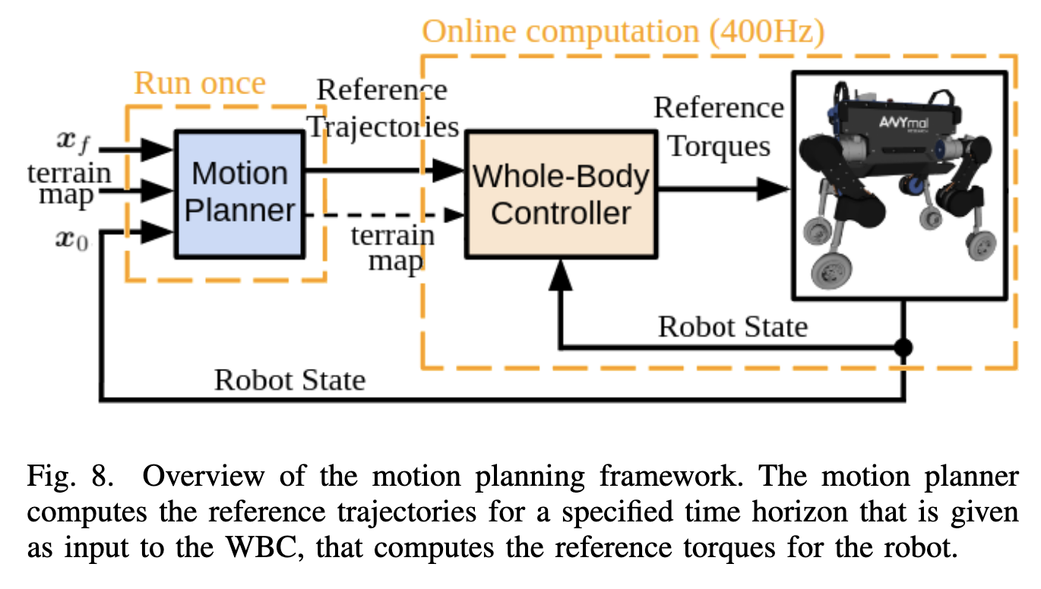
Trajectory Optimization for Wheeled-Legged Quadrupedal Robots Driving in Challenging Terrain

Slide 2
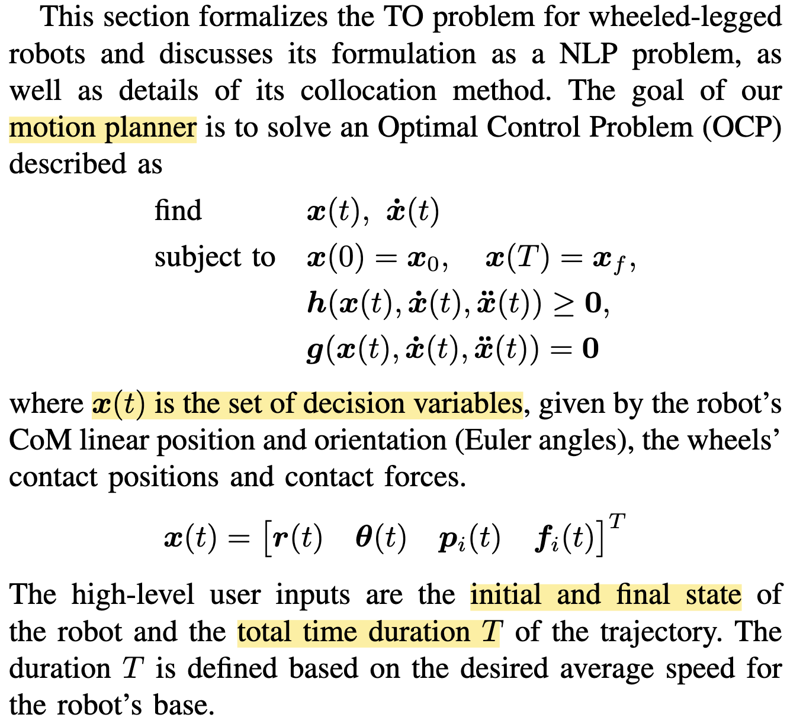
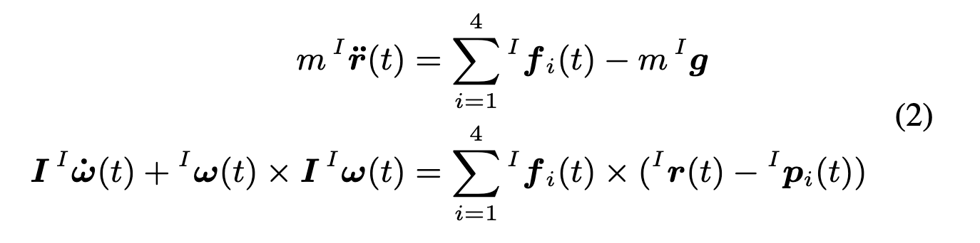
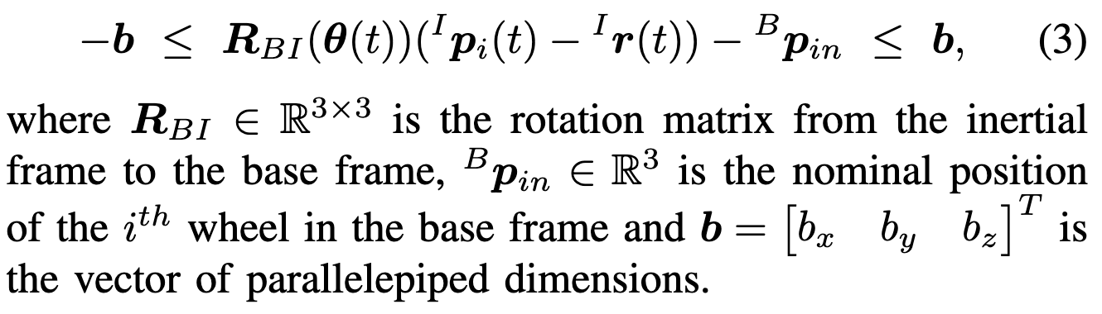
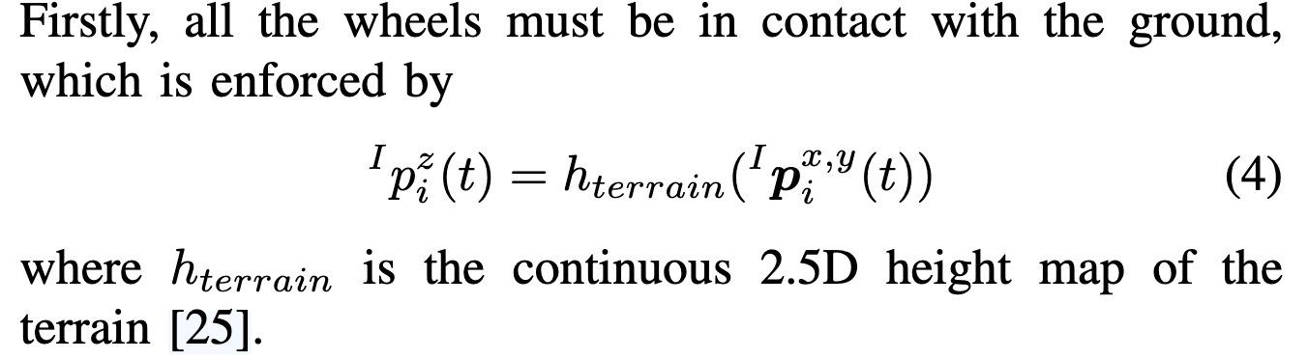
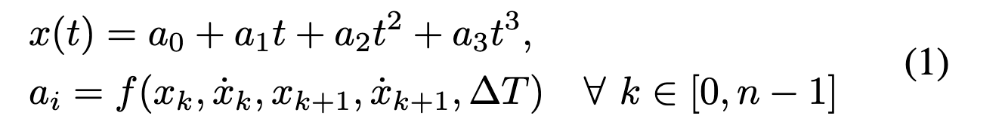
Trajectory Optimization for Wheeled-Legged Quadrupedal Robots Driving in Challenging Terrain
1、Dynamic constrain
2、kinematic constrain
3、Wheels’ contact constraints

Slide 3
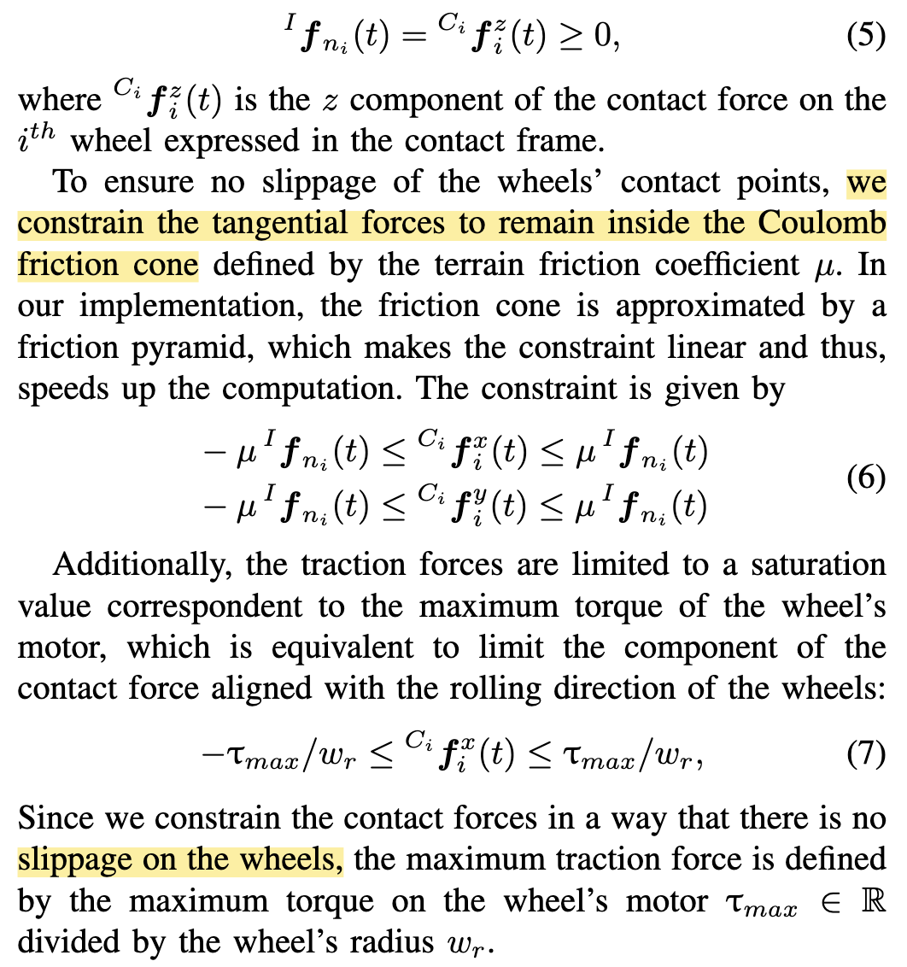
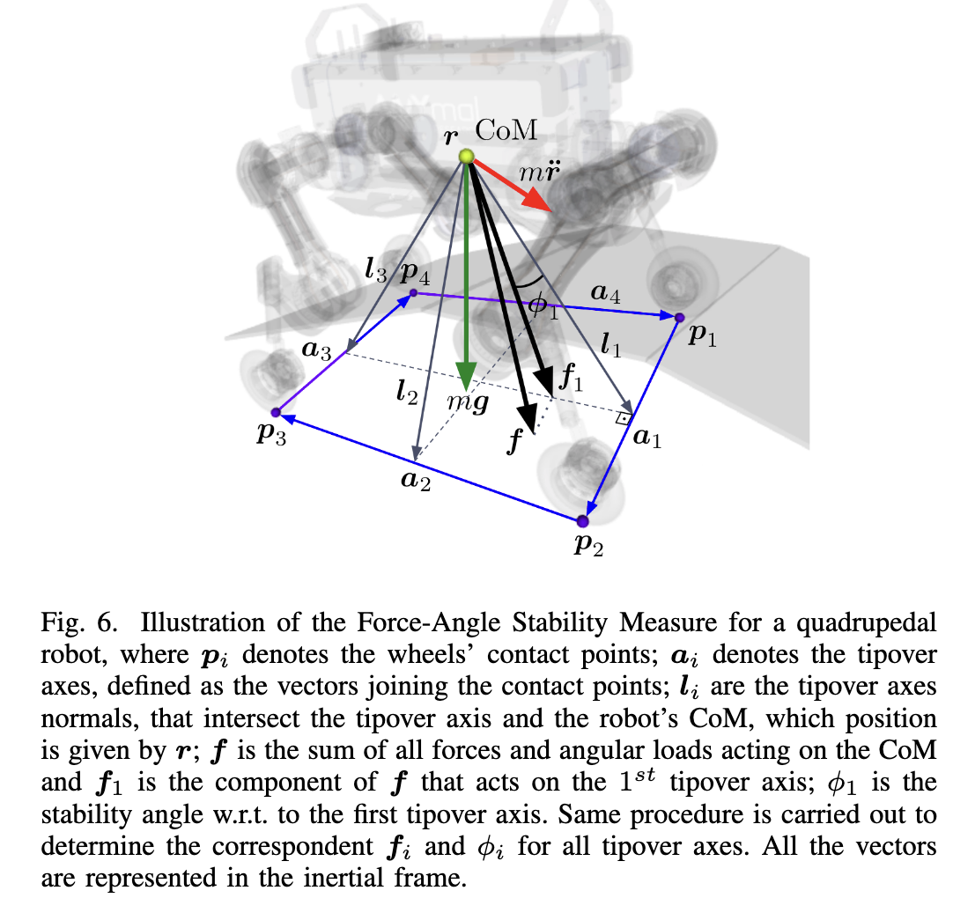
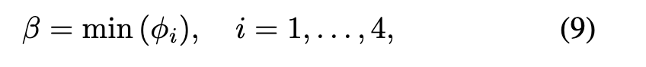
Trajectory Optimization for Wheeled-Legged Quadrupedal Robots Driving in Challenging Terrain
4、Wheels’ force constrain
5、 Stability constraint

Slide 4
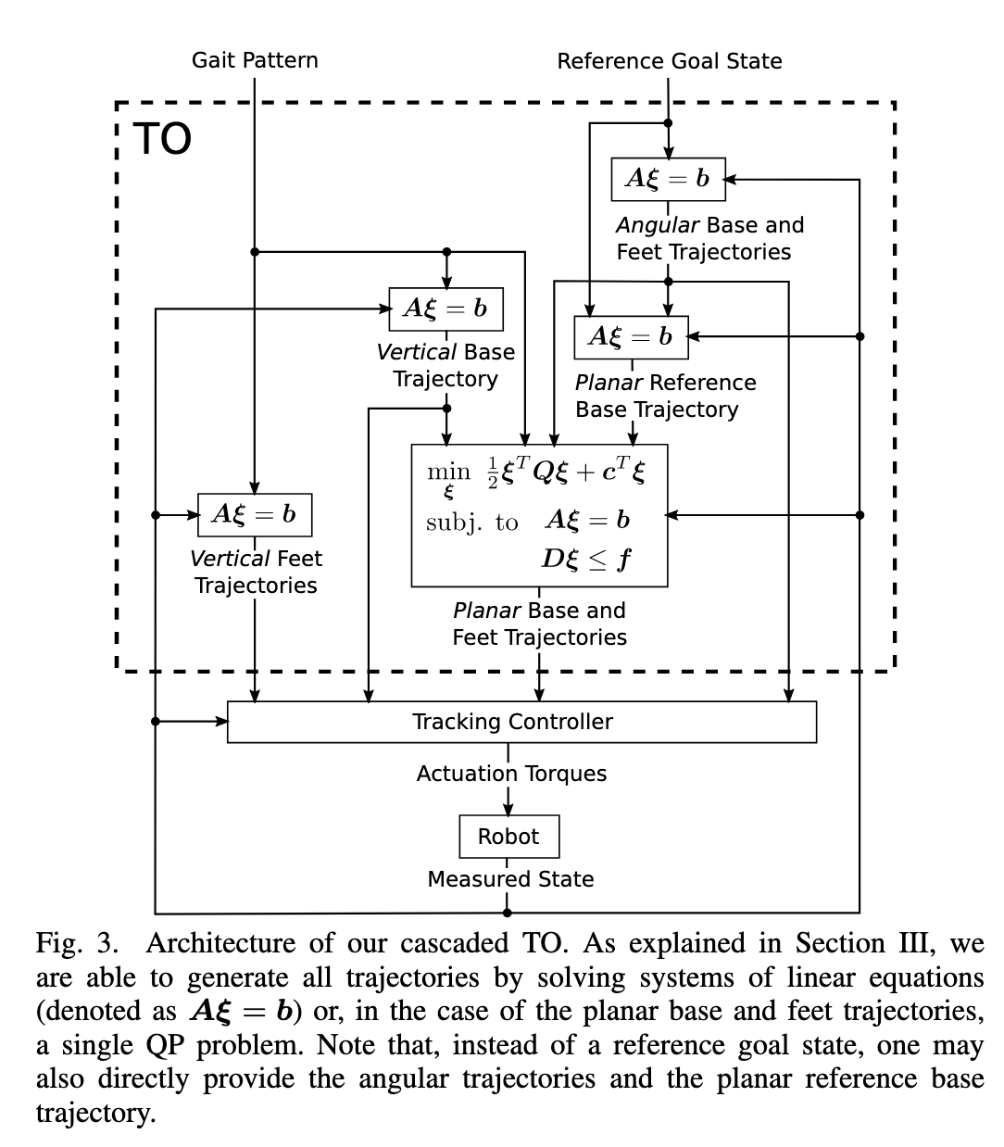
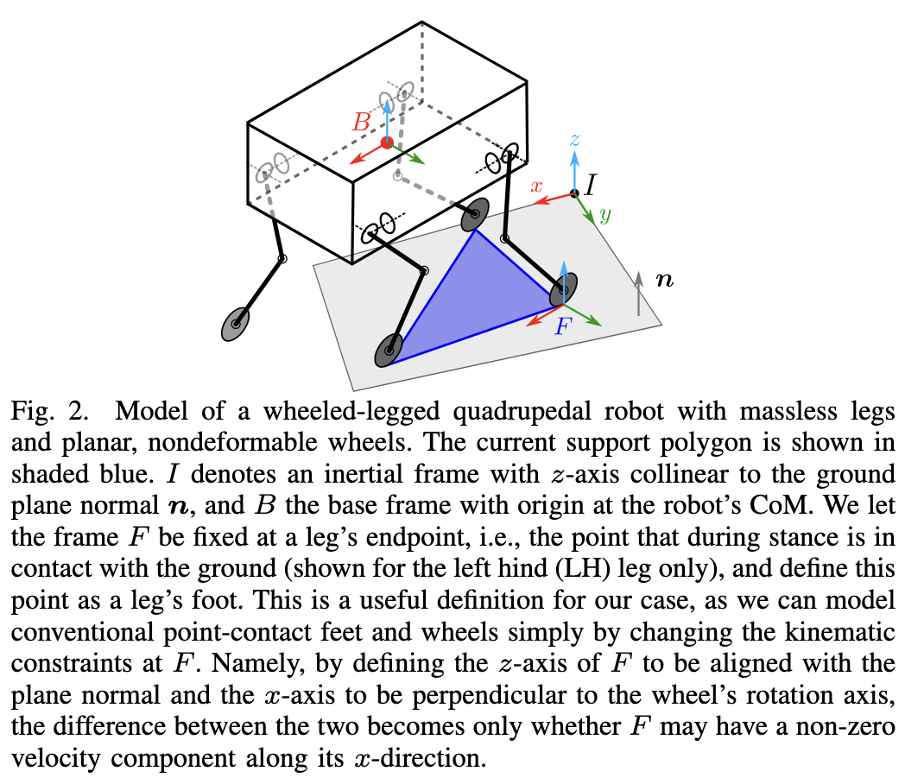
Trajectory Optimization for Wheeled-Legged Quadrupedal Robots using Linearized ZMP Constraints

Slide 5
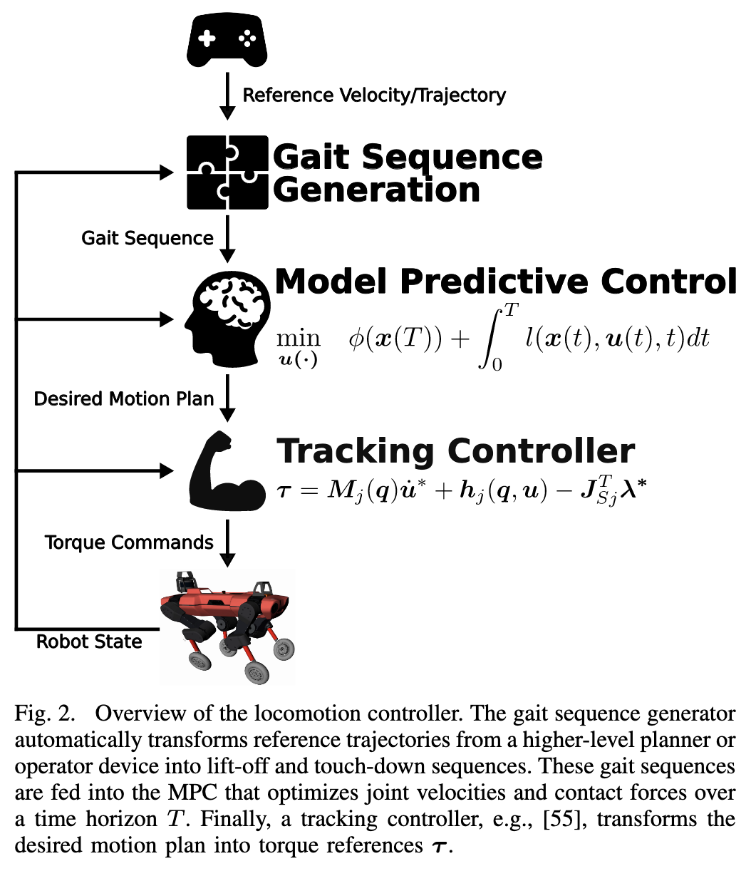
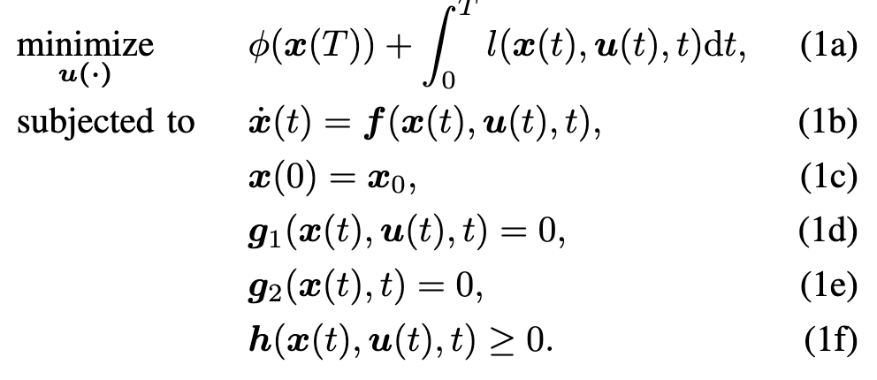
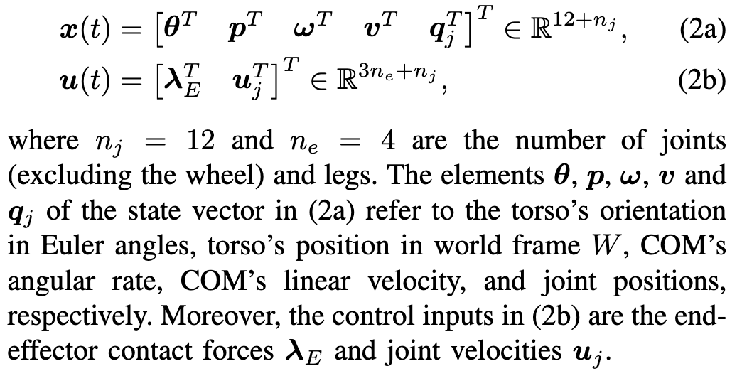
Whole-Body MPC and Online Gait Sequence Generation for Wheeled-Legged Robots

Slide 6
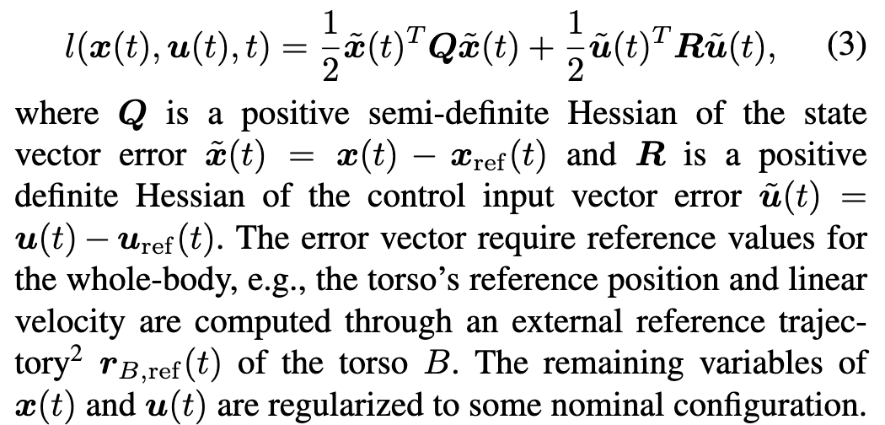
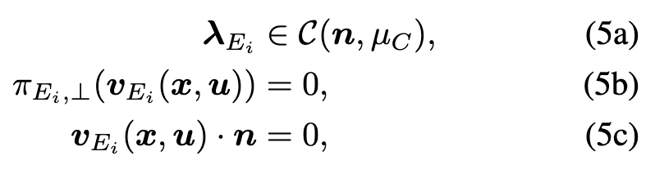
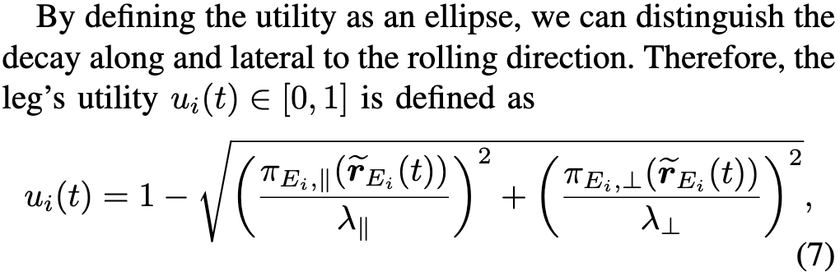
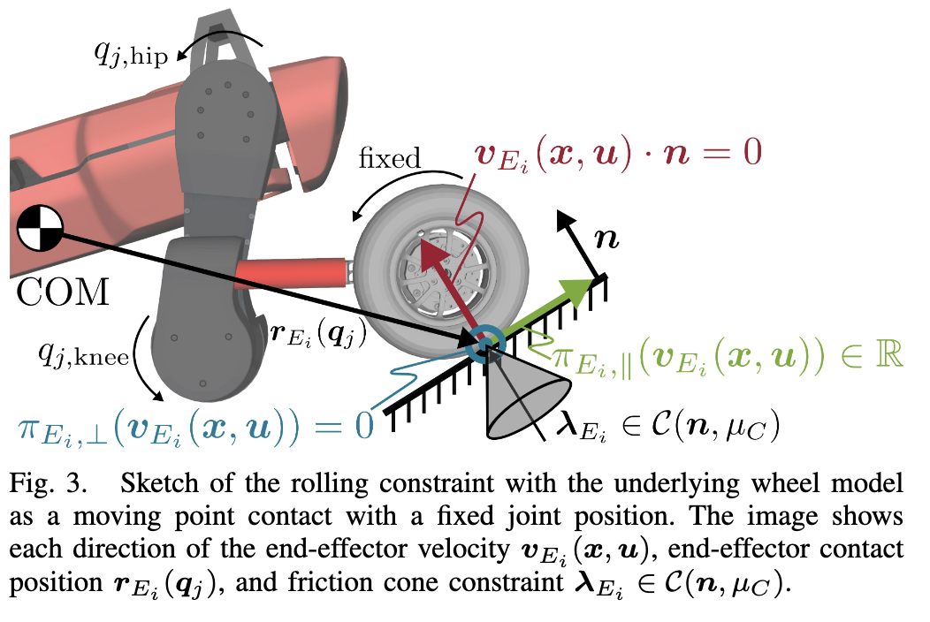
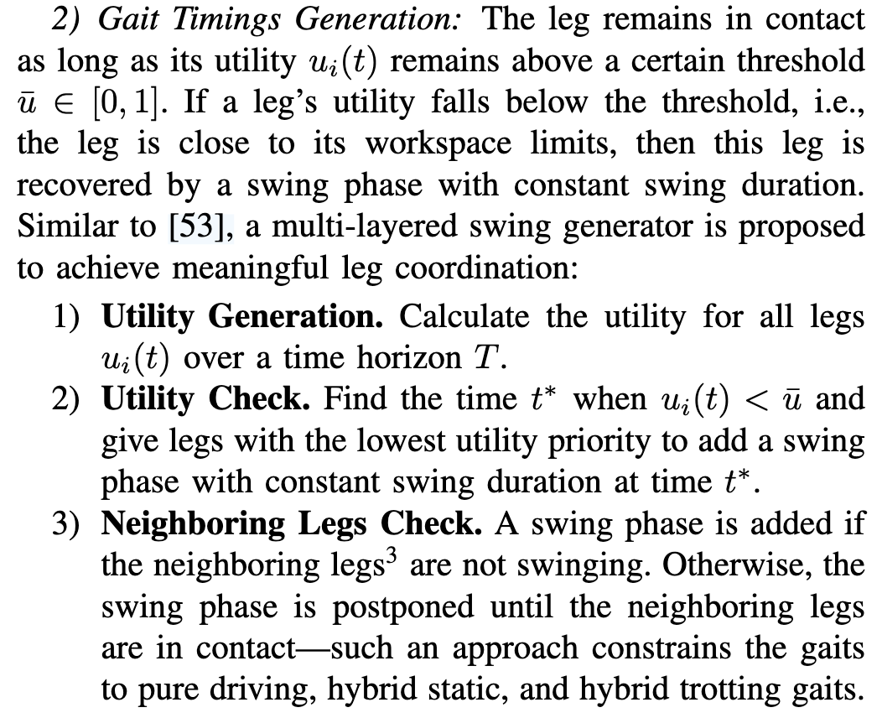
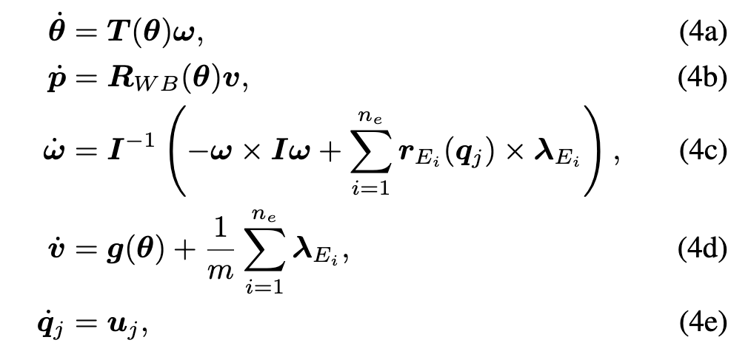
Whole-Body MPC and Online Gait Sequence Generation for Wheeled-Legged Robots
1、cost function
3、rolling constrain
4、Gait Sequence Generation
2、dynamic constrain

Slide 7
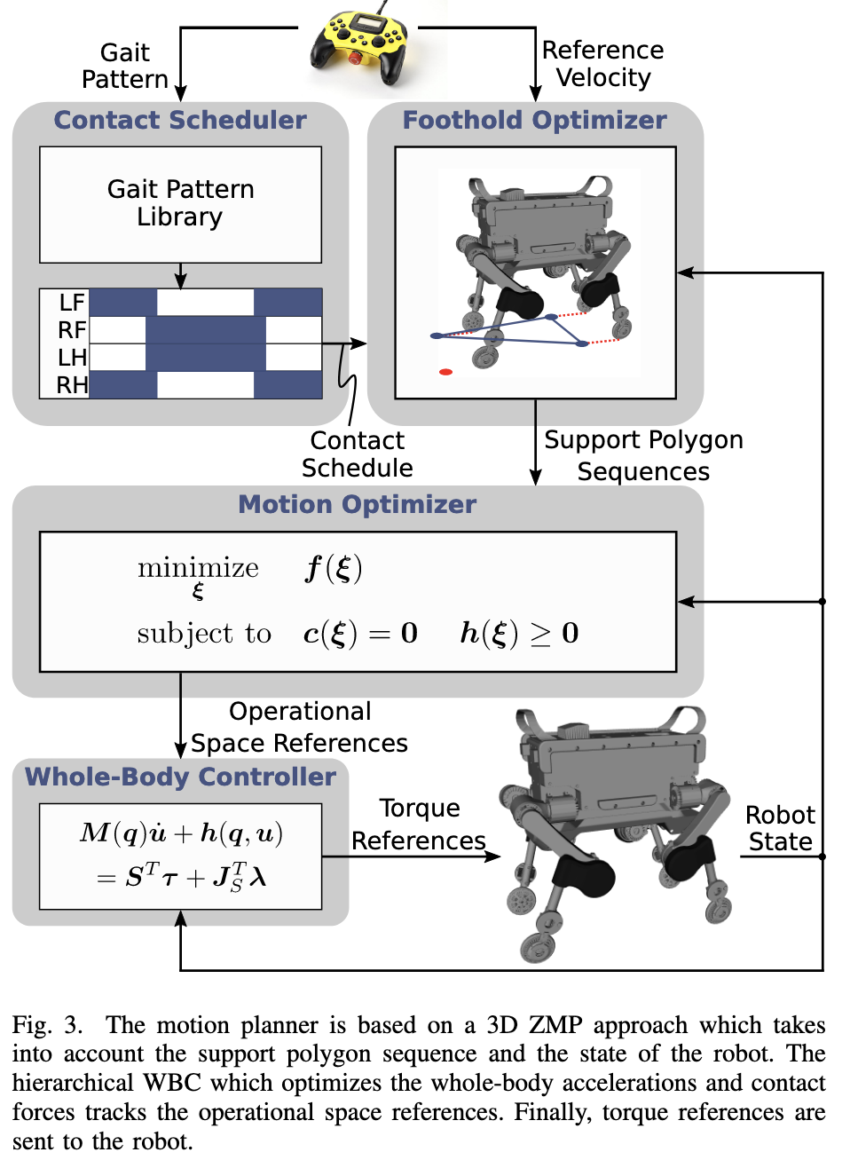
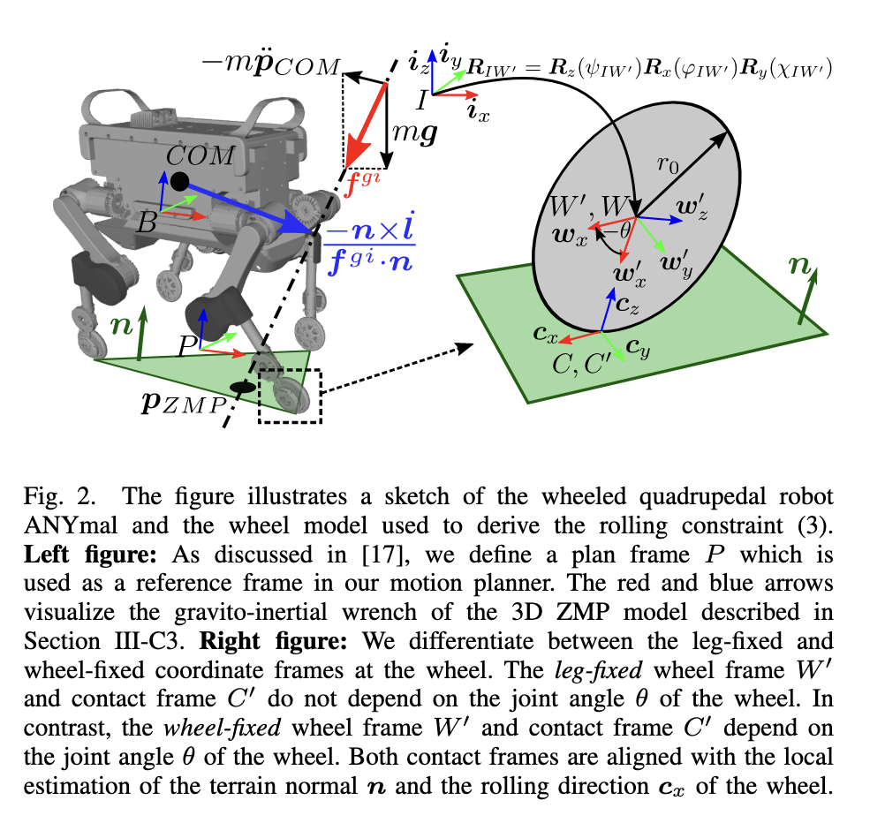
Keep Rollin’ – Whole-Body Motion Control and Planning for Wheeled Quadrupedal Robots

Slide 8
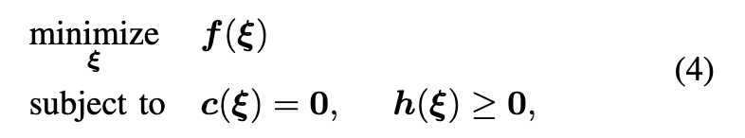
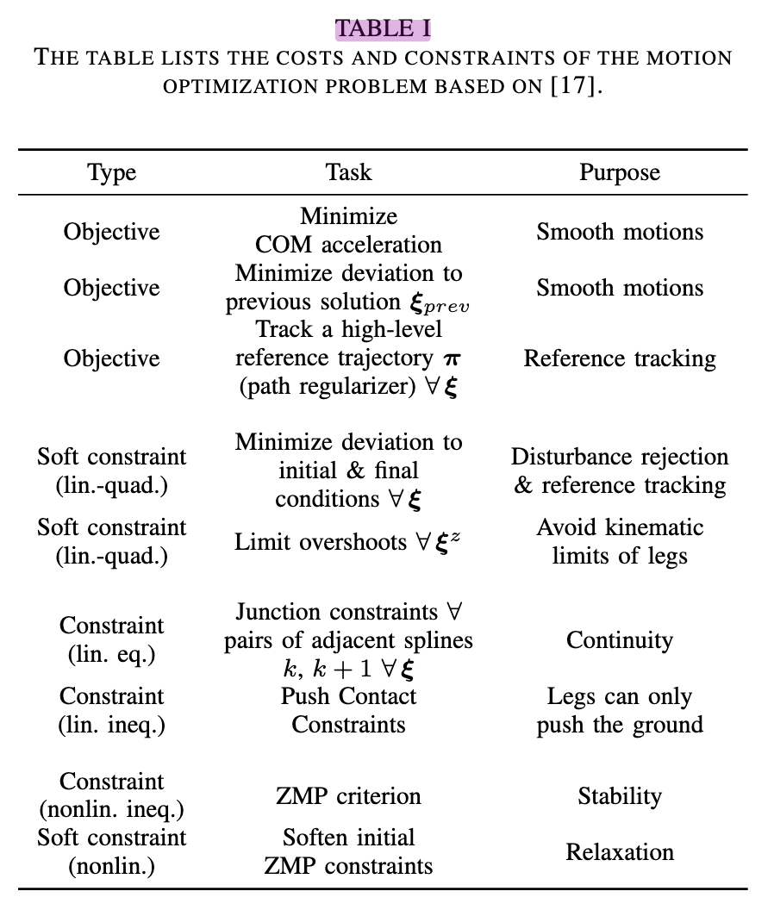
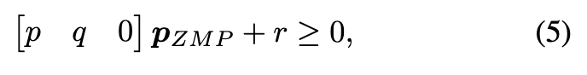
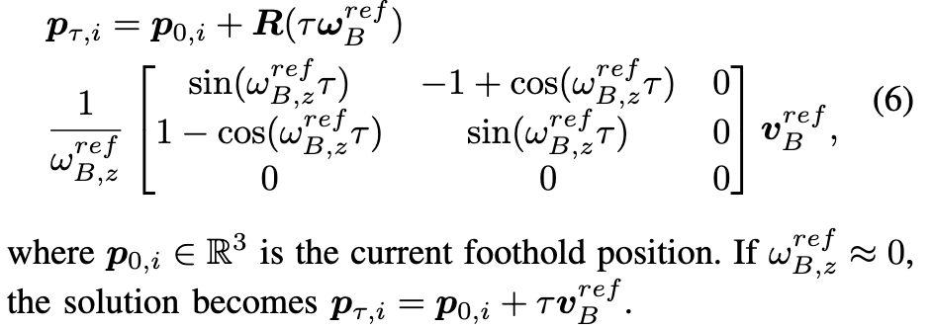
Keep Rollin’ – Whole-Body Motion Control and Planning for Wheeled Quadrupedal Robots
1、 Motion Optimizer :
1、ZMP inequality constraint:
2、 Deformation of support polygons while driving :

Slide 9
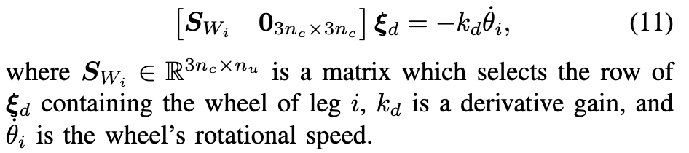
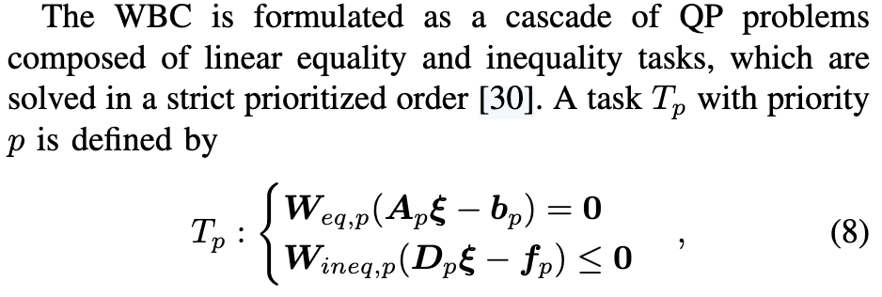
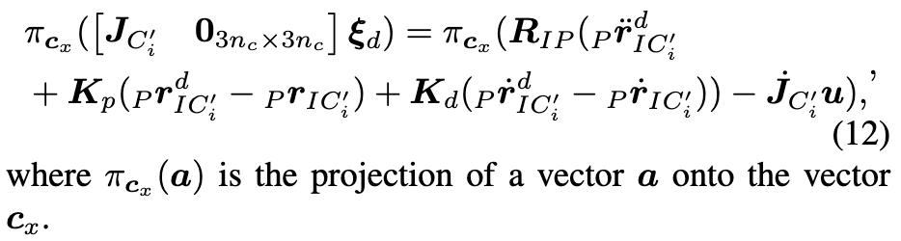
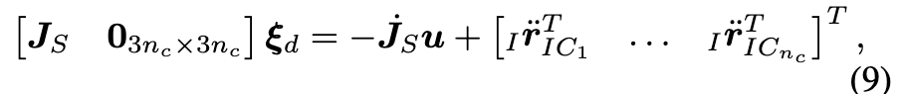
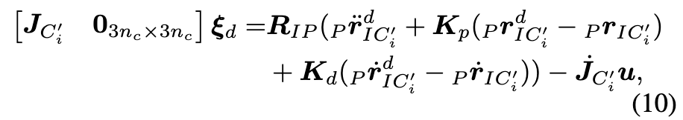
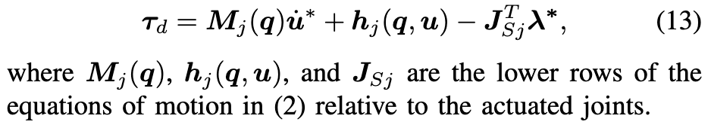
Keep Rollin’ – Whole-Body Motion Control and Planning for Wheeled Quadrupedal Robots
1、 whole-body controller:
4、Swing wheel rotation minimization:
5、Ground leg motion tracking:
2、Nonholonomic rolling constraint
3、COM linear and angular motion tracking
6、Torque Generation

Slide 10
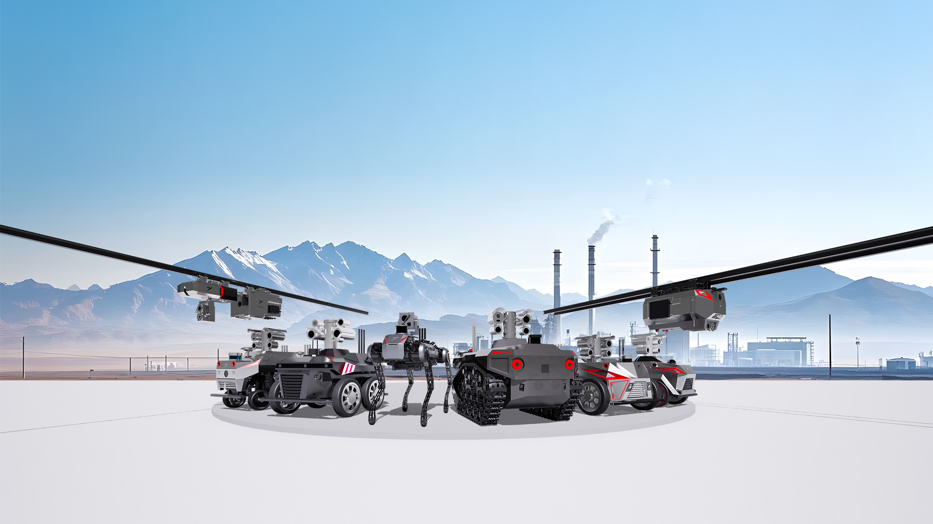
Thank you

